Slide 1

Progressive Web Apps

Slide 2
Let's start
•https://www.youtube.com/watch?v=3tb-1MWg44Y

Slide 3
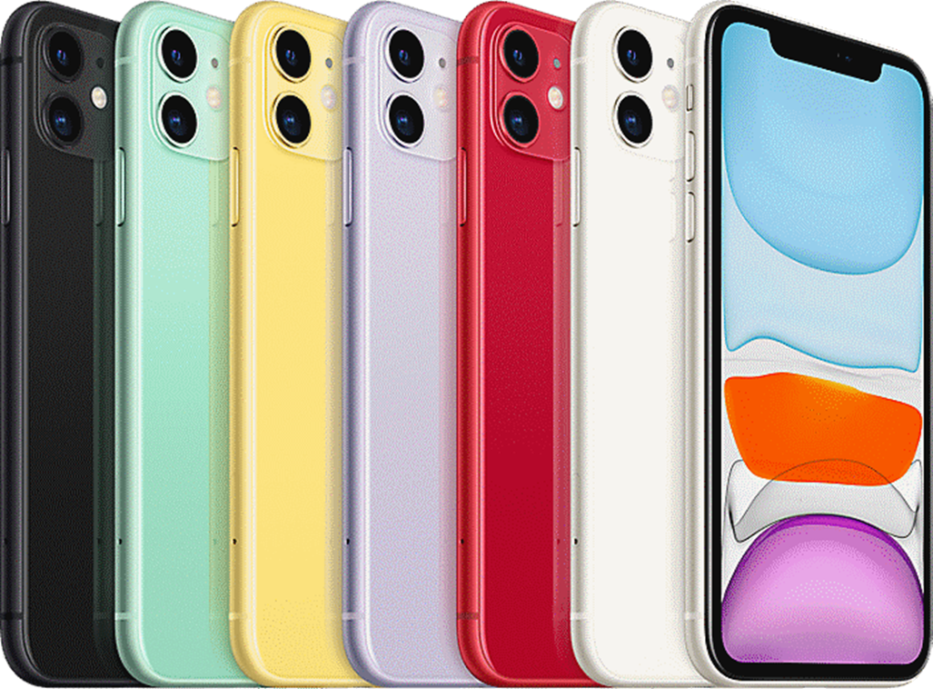
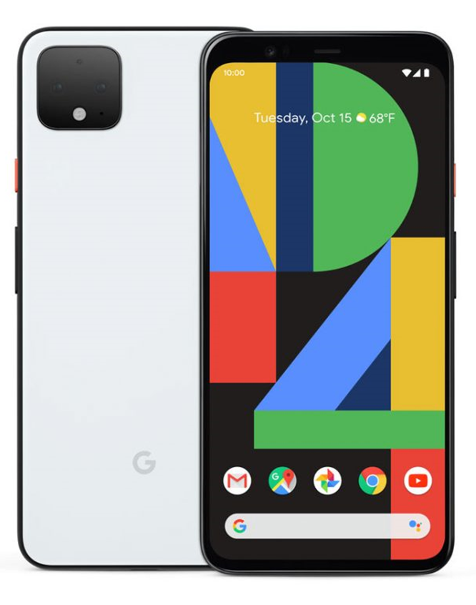
To now

Slide 4
Users have expectations
•Fast
•Reliable
•Easily available
•Part of the phone
•Familiar interactions
•‘App’ Like
•Not what the mobile web experience gives you

Slide 5
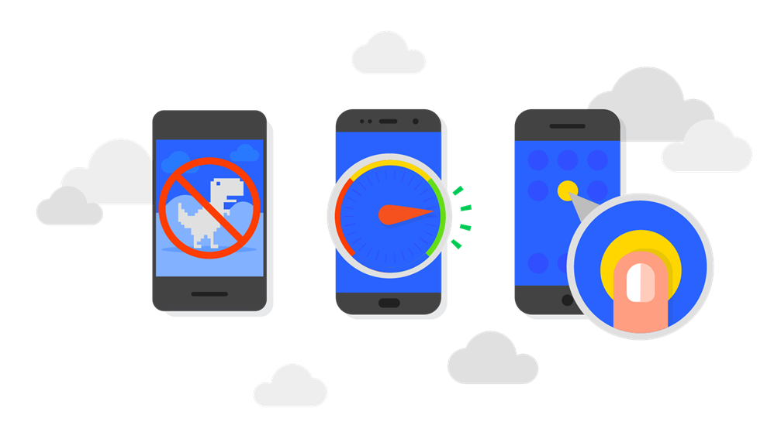
What are PWA?
•“Progressive Web Apps are user experiences that have the reach of the web, and are:
Reliable - Load instantly and never show the dinosaur, even in uncertain network conditions.
Fast - Respond quickly to user interactions with silky smooth animations and no janky scrolling.
Engaging - Feel like a natural app on the device, with an immersive user experience.
•This new level of quality allows Progressive Web Apps to earn a place on the user's home screen”
•https://developers.google.com/web/progressive-web-apps/

Slide 6
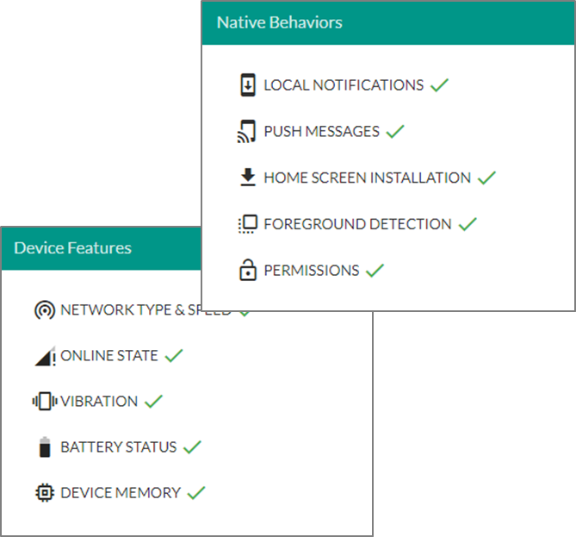
Common misconceptions-PWA
•only work in Chrome
•not as smooth as native apps
•don't work in full-screen mode
•have to be SPAs
•building offline-first is difficult
•can't access device APIs
•WRONG!!
•check https://whatwebcando.today/ to see what your mobile browser can do

Slide 7
Responsive web design
Responsive Web design is the approach of designing a web application to the user’s behavior and the display environment based on screen size, platform and orientation.
•This means we design and develop web applications which is suitable to view in browsers, mobile screens, tablets and other devices.
There are different approaches in achieving this.

Slide 8
The Viewport
This is the user's visible area of a web page.
HTML5 allows designers to control the viewport using the <meta> tag

Slide 9
Media queries
We can use the @media rule to include set of CSS properties only if a certain condition is true.
Using media queries is one of the main techniques used in responsive web design.
You can also use media queries to apply different rules (looks and feels) for different devices.

Slide 10

Try it out!
https://developer.mozilla.org/en-US/docs/Learn/CSS/CSS_layout/Media_queries

Slide 11

Favicons(home page images) and web manifest

Slide 12
Touch icons and Launch images
Apple invention originally, from when third party apps were all web-based
At their most basic level, they allow a website to specify a custom icon which should be shown when the page is added to the Home Screen
Further parts allow the page to customise the behaviour a little further

Slide 13
Icon/ Web Manifest Generator
Can use a generator to give you a minimal set of launch icons
Start with an image at least 512 x 512
Go to: http://realfavicongenerator.net/

Slide 14
What you need to add
Download the package and add to your project folder
Look at all the images produced
Look at the manifest produced
Add the HTML in the <head> of your page

Slide 15
Web App manifest
This helps style the PWA – makes it more native app like
Need a manifest file for a progressive web application
•JSON format
•Link it to your page
<link rel="manifest" href="manifest.json">

Slide 16
Web App Manifest
•A short_name for use as the text on the users home screen
"short_name": “Veggies"
•A name for use in the Web App Install banner
"name": “Our vegetable page“
•Start URL - Which page the app should start with - if not provided its the current page - but you may want to add a query string
"start_url": “index.html"

Slide 17
Web App Manifest
•Icons - A set of icons for launching and saving to home page
•You need a 512 size one as the biggest – This acts as the splash screen

Slide 18
Web App manifest
•Background colour stays on screen until pages first render - use same colour as loading page as a tip
"background_color": "#2196F3"
•Theme Colour - Changes colour of toolbar
"theme_color": "#2196F3"
•Also set <meta name="theme-color" content="#db5945"> in meta tags

Slide 19
Web App manifest
•Launch Style – can set how the page is launched
•Display
"display": "standalone" or "display": "browser"
Orientation - "orientation": "landscape“
•Description
"description": “Our first attempt at the start of a PWA!“
•Language
"lang": "en"

Slide 20
Further reading
https://developer.mozilla.org/en-US/docs/Web/CSS/Media_Queries/Using_media_queries
https://developers.google.com/web/fundamentals/engage-and-retain/web-app-manifest/
http://caniuse.com/#feat=web-app-manifest
https://developer.mozilla.org/en-US/docs/Web/Manifest
https://developers.google.com/web/fundamentals/app-install-banners/
https://www.w3.org/TR/appmanifest/

Slide 21
Summary
Progressive web apps
Making it responsive
CSS media queries
Web App manifest

